Slide 1
Language models can explain neurons in language models Towards Monosemanticity: Decomposing Language Models With Dictionary Learning Dictionary Learning I
Presenter: Yutong He
Mechanistic Interpretability - Main Seminar
CL, Heidelberg
2024/12/5
Notes:
today im going to present the topic dictionary learning
including two papers
by open ai

Slide 2
Table of contents
01
02
03
04
05
Motivation
Bricken et al. (2023)
Bills et al. (2023)
Source
Discussion
Notes:
My presentation follows this structure.
interpretability

Slide 3
01
Motivation
Can we apply dictionary learning to Mechanistic Interpretability?
Notes:
When it comes to the motivation

Slide 4
Dictionary Learning
Definition: Dictionary learning is a sparse encoding method that finds the “bases” (key components) of a set of vectors.
It provides a numerical way to calculate these bases, preserving the original data in a lossless manner.
In the case of Mechanistic Interpretability?
Goal = identify a set of “features” (dictionary) that represent neuron activations.
Notes:
Firstly, let's go through a short introduction to Dictionary learning.
Then how can we apply this to MI?

Slide 5
Motivation
Language models can explain neurons in language models
What patterns in text cause a neuron to activate?
Apply automation to the problem of scaling an interpretability technique to all the neurons
However, the typical neurons appeared quite polysemantic due to superposition.
Towards Monosemanticity: Decomposing Language Models With Dictionary Learning
Understand superposition by decomposition
Finding basis vectors of neurons as features
Notes:
In terms of the first paper, the question they focus on is: What patterns in text cause a neuron to activate?
And as for the solution ,they propose an automation method to the problem of scaling this technique to all the neurons
However, the typical neurons are mostly and generally polysemantic due to superposition, a phenomenon that we have discussed in the previous sessions. I think this is intuitive, because it is the linear combinations of neurons are fit during training. So, when it comes to the second paper, it kind of makes a supplement to the first paper, which provides a perspective to understand superposition by decomposition.
That is, apply dictionary learning to solve this problem, to find the basis vectors of neurons as features

Slide 6
02
Method & Results
Language models can explain neurons in language models

Slide 7
Method
Models
Subject model $M_{subject}$, to be interpreted.
Explainer model $M_{explainer}$, to come up with hypotheses and explanations.
Simulator model $M_{simulator}$, to predict activations based on the hypothesis.
Algorithm
Explain the activations $A_{i}$of neuron from $M_{subject}$, using $M_{explainer}$.
Simulate activations $A_{i}′$ using $M_{explainer}$, conditioning on the explanation $E_{i}$, given on same text excerpts.
Score the explanation by comparing${ A}_{i}′$ and$A_{i}$.
Notes:
In their method, we firstly define three models.

Slide 8
Algorithm – Step 1: explain
Explain the activations $A_{i}$of neuron from $M_{subject}$, using $M_{explainer}$
Given neuron id $i$ and its activation $A_{i}$ on input text $T$, $M_{explainer}$gives an explanation $E_{i}$ on a prompt
Notes:
On a prompt, guessing the neuron is activating on specific features among this paragraph.

Slide 9
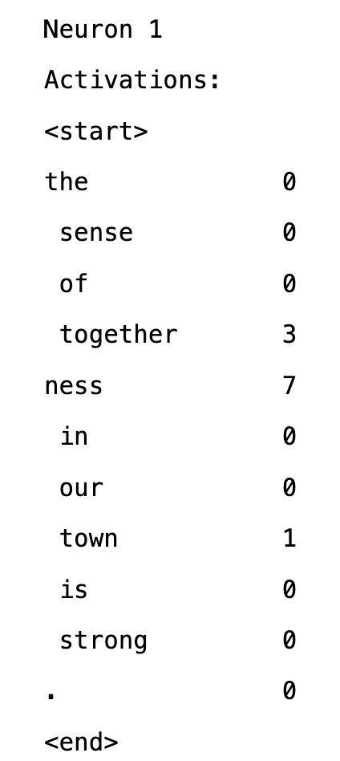
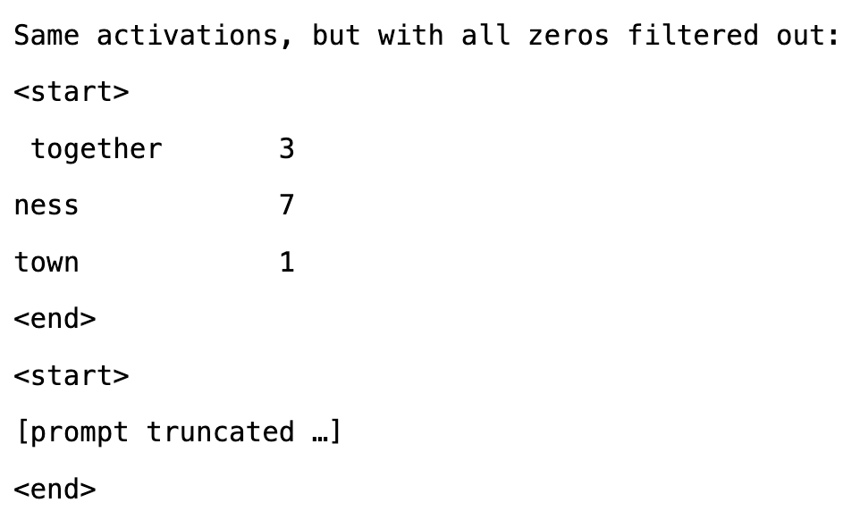
Algorithm – Step 1: explain
Activations are normalized to a 0-10 scale and discretized to integer values
negative activation values mapping to 0.
the maximum activation value ever observed for the neuron mapping to 10.
[For sparse activations] repeat the token/activation pairs with non-zero activations after the full list of tokens, helping the model to focus on the relevant tokens.
Notes:
Activations are normalized to a 0-10 scale and discretized to integer values, with negative activation values mapping to 0 and the maximum activation value ever observed for the neuron mapping to 10.
to emphasize it

Slide 10
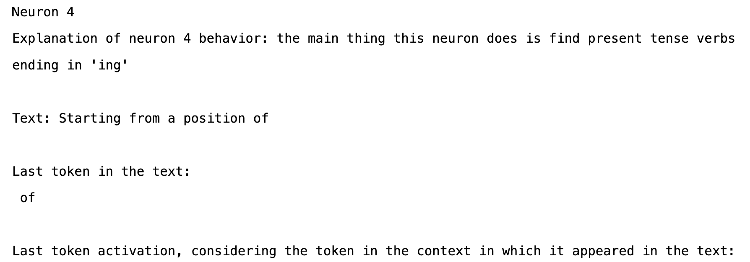
Algorithm – Step 2: simulate
Simulate activations $A_{i}′$ using $M_{explainer}$, conditioning on the explanation $E_{i}$, given on same text excerpts.
One at a time
Notes:
The prompt may look like this.
There are two ways of simulation, one is One token at a time, another is All at once

Slide 11
Algorithm – Step 2: simulate
Simulate activations $A_{i}′$ using $M_{explainer}$, conditioning on the explanation $E_{i}$, given on same text excerpts.
One at a time
All at once
Notes:
where we input all tokens labeled as unknown, to provide the context information ,and in the same time it won't cause information leak of the activation values.

Slide 12
Algorithm – Step 3: score
Score the explanation by comparing${ A}_{i}′$ and$A_{i}$.
Explanation Score: a measure of a language model's ability to compress and reconstruct neuron activations using natural language.
[Main] Correlation scoring $ρ$
Ablation scoring
Human scoring
Evaluation set
Random only
Top and Random
Notes:
The paper proposed 3 metrics to measure the explanation score.
correlation coefficient between the true and simulated activations
Ablation scoring
Main idea: replace the real neuron with the simulated neuron, and check whether the network behavior is preserved
Metirc: Jensen-Shannon Divergence between the perturbed and original model's output logits.
human labelers rank 5 proposed explanations
Considering the performance and computational cost, they use correlation scoring as main metric.
Evaluation set
Random only: focus on the ability of generalization
a mixture of top and random dataset: focus on the core function of neurons, the top here mean the text with higher activations

Slide 13
Experiment
Models
Subject model $M_{subject}$: GPT-2 XL.
Explainer model $M_{explainer}$, GPT-4.
Simulator model $M_{simulator}$, GPT-4.
Data
Text excerpts from the training split of the $M_{subject}$ 's pre-training dataset
Random 64-token contiguous subsequence
Use 5 "top-activating" text excerpts
Notes:
These are some details of experiment.
We use 5 top activation text excerpts in top and random dataset
The top-activation here means the text has at least one token with an extremely large activation value.
If we only use top-activating sequences in the explanation generation prompt, it can yield the best explanation scores

Slide 14
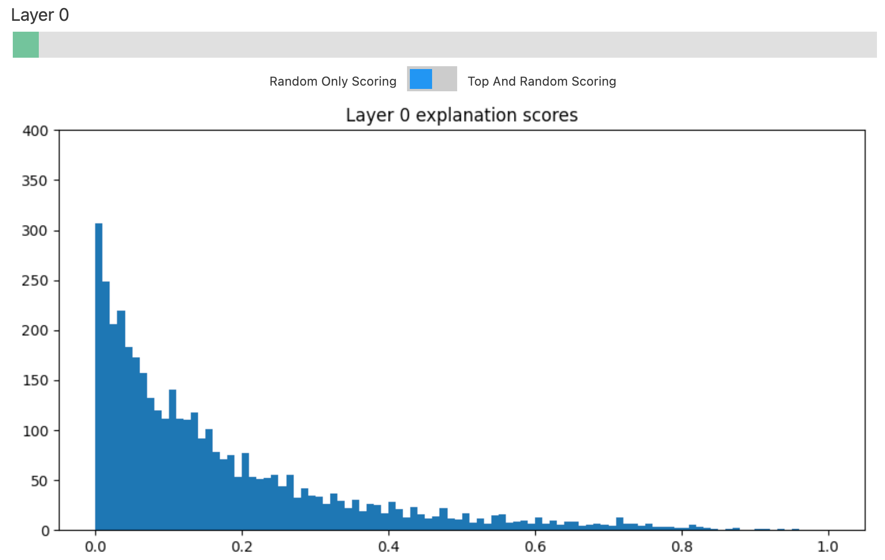
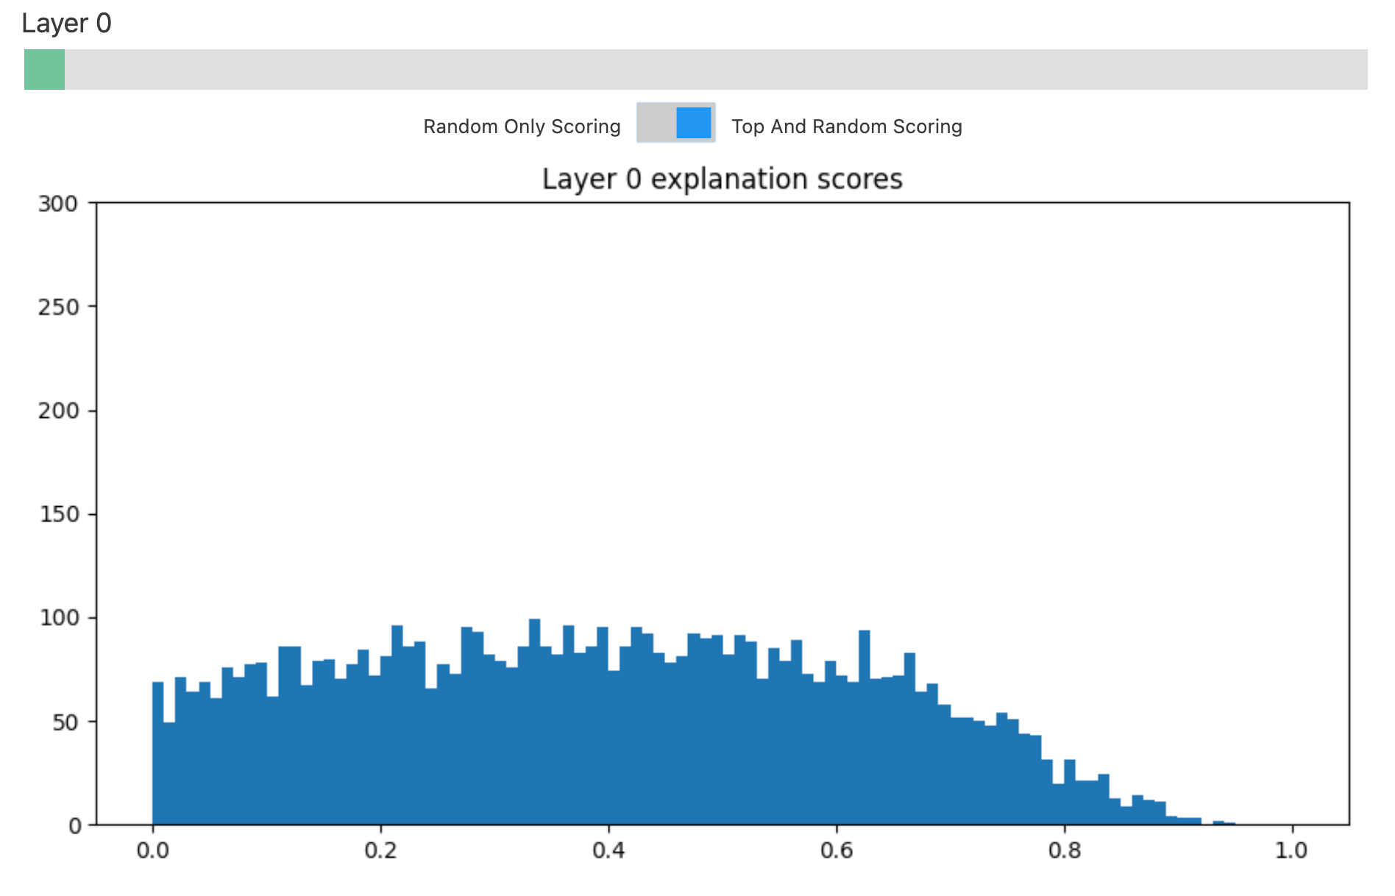
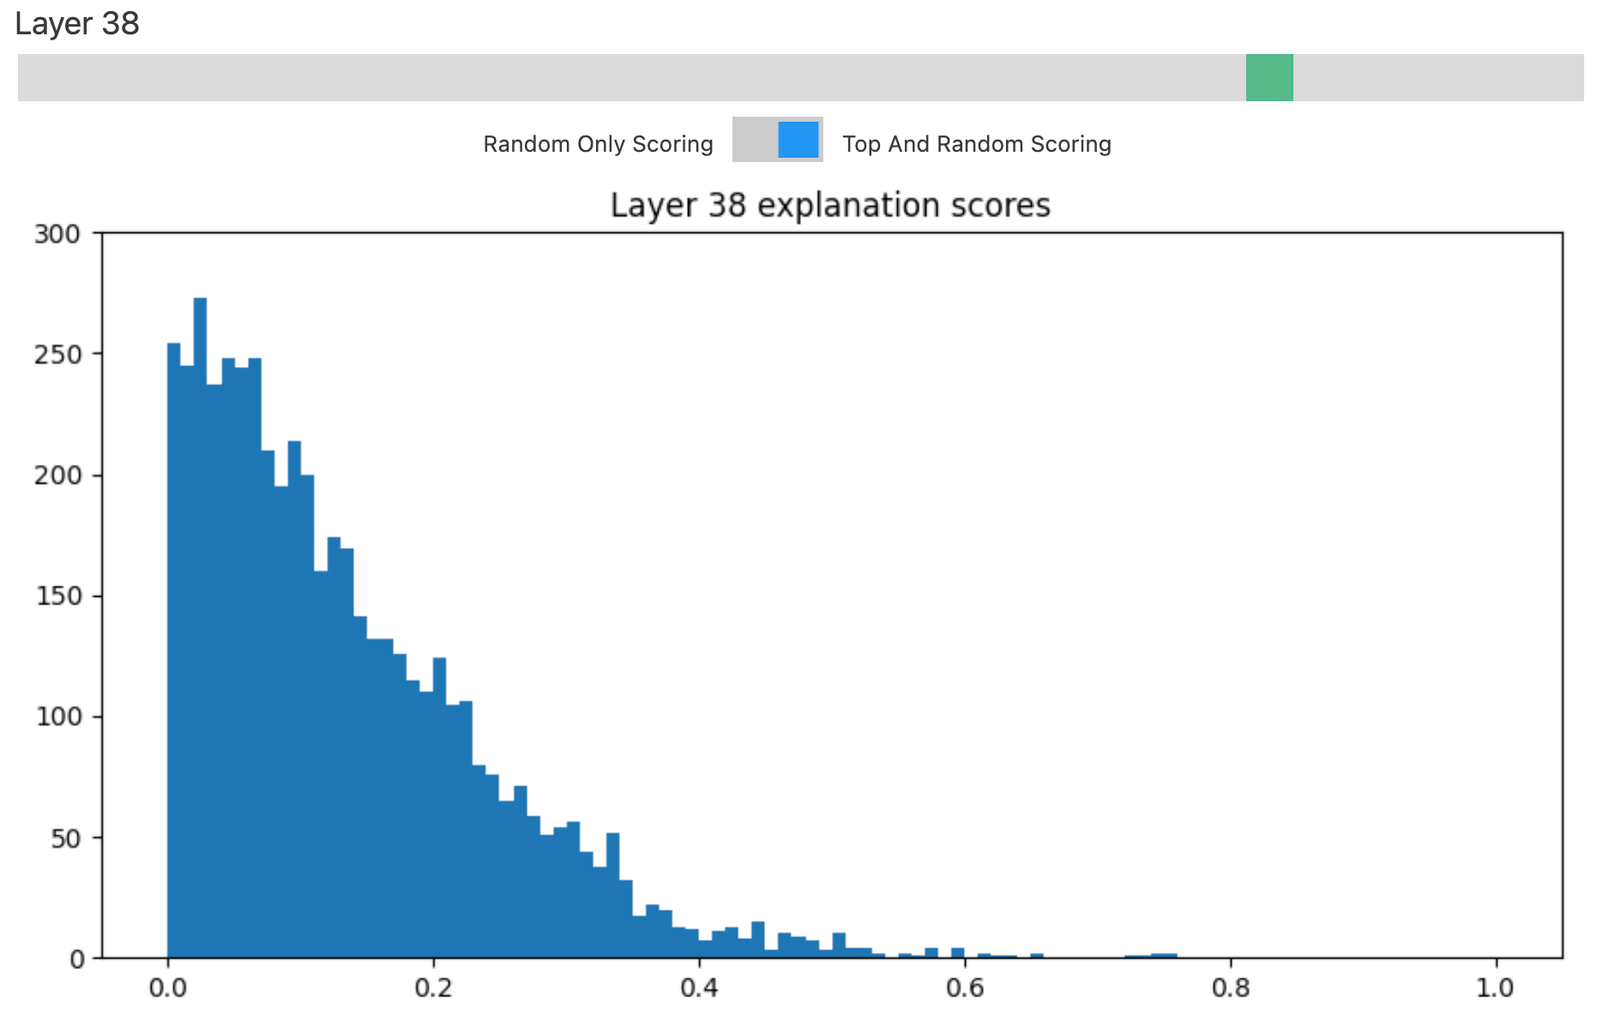
Results: Correlation scoring
Random-Only Scoring
average score: 0.037
0.2% of total neurons above 0.7
0.03% of total neurons above 0.9
Top and Random Scoring
average score: 0.151
1.7% of total neurons above 0.7
0.06% of total neurons above 0.9
Scores generally decrease when going to later layers.
Notes:
Here are the results of correlation scoring
where we can see
in the random-only scoring, really low, and small proportion of neurons can get a high score in explanation.
In Top and Random Scoring, where they mixed 50% top activation texts and 50% random texts, the average score is higher, but still low. The performance is better.
For example, in layer 38, the explanation scores are mostly closed to 0 or 0.1

Slide 15
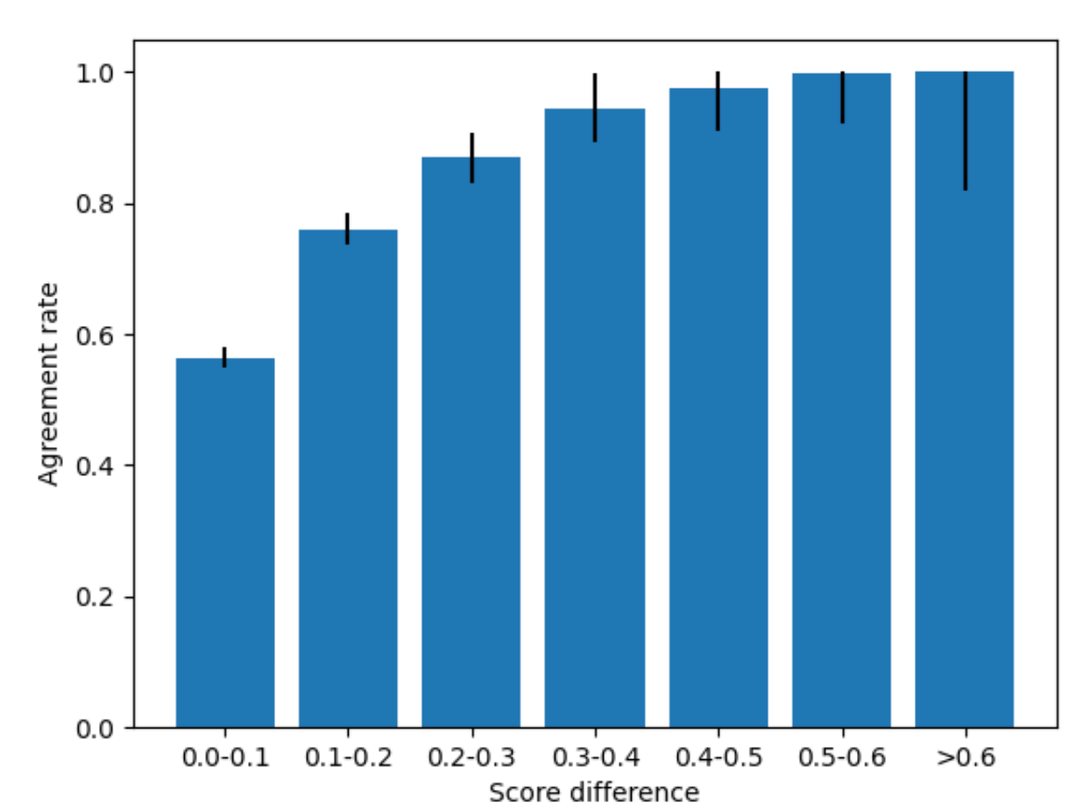
Results: Human scoring
Among 5 explanations proposed by GPT-4, Humans tend to prefer higher-scoring explanations over lower-scoring ones, with the consistency of that preference increasing as the size of the score gap increases.
Notes:
They also discover the consistency of that

Slide 16
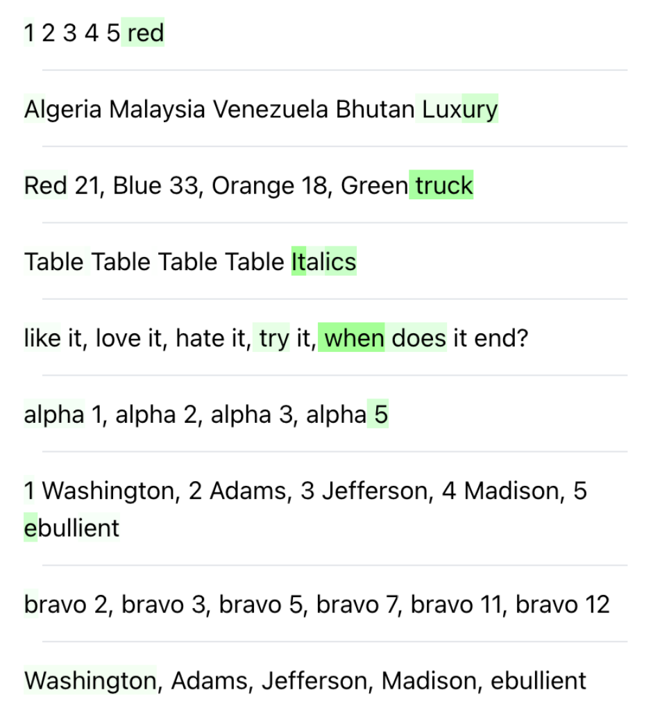
Interesting neurons!
"simile" neuron
a neuron for phrases related to certainty and confidence
a neuron for things done correctly
context-sensitive neurons
a pattern break neuron
a post-typo neuron
Notes:
During the experiment, they discover interesting neurons such as neurons focusing on similarity, or phrases related to certainty and confidence, or things done correctly
They also find context-sensitive neurons, such as pattern break neuron and post-typo neuron.
For example, a pattern break neuron activates in patterns like this.

Slide 17
Attack on superposition - Direction Finding
The typical neurons appeared quite polysemantic, because it is the linear combinations of neurons are fit during training.
The high-level idea is to optimize a linear combination of neurons = virtual neuron.
Optimize $θ$ to explain the behaviours of virtual neuron (a direction of neurons).
Explanation step: Optimize over explanations by searching for an explanation that explains $a_{θ}$ well (i.e. achieves a high explainer score).
Update step: Optimize over $θ$by computing the gradient of the score and perform gradient ascent.
Notes:
After previous experiments, they find that The typical neurons appeared quite polysemantic.
Therefore, Another method that this paper proposed is direction finding, focusing the issue of superposition.
What we are looking for is an optimized theta to form an activation that can achieve higher explainer score.And the theta here is a linear combination of neurons
There are two steps, one is explanation step, where we optimize over explanations by searching for a best explanation on current activation.
Secondly, we update the theta, by computing the gradient of the score and perform gradient ascent.
done!!
Note that our correlation score is differentiable with respect to $θ$, so long as the explanation and simulated values are fixed.

Slide 18
03
Method & Results
Towards Monosemanticity: Decomposing Language Models With Dictionary Learning
Notes:
Let’s move on to the second paper, discussing the dictionary learning on superposition

Slide 19
Superposition Hypothesis
Neural networks “want to represent more features than neurons they have” via a kind of “noisy simulation”
What we expect: an overcomplete basis
And the feature activations should be sparse
Therefore, we seek a decomposition which is sparse and overcomplete.
Notes:
The research follows the hypothesis of superposition.
A consequence of this is that we should expect the feature directions to form an overcomplete basis. our decomposition should have more features than neurons.
Plus the feature activations should be sparse, because sparsity is what enables this kind of noisy simulation. which indicates that most neurons fit the noisy information, while only a few of it activates specific feature

Slide 20
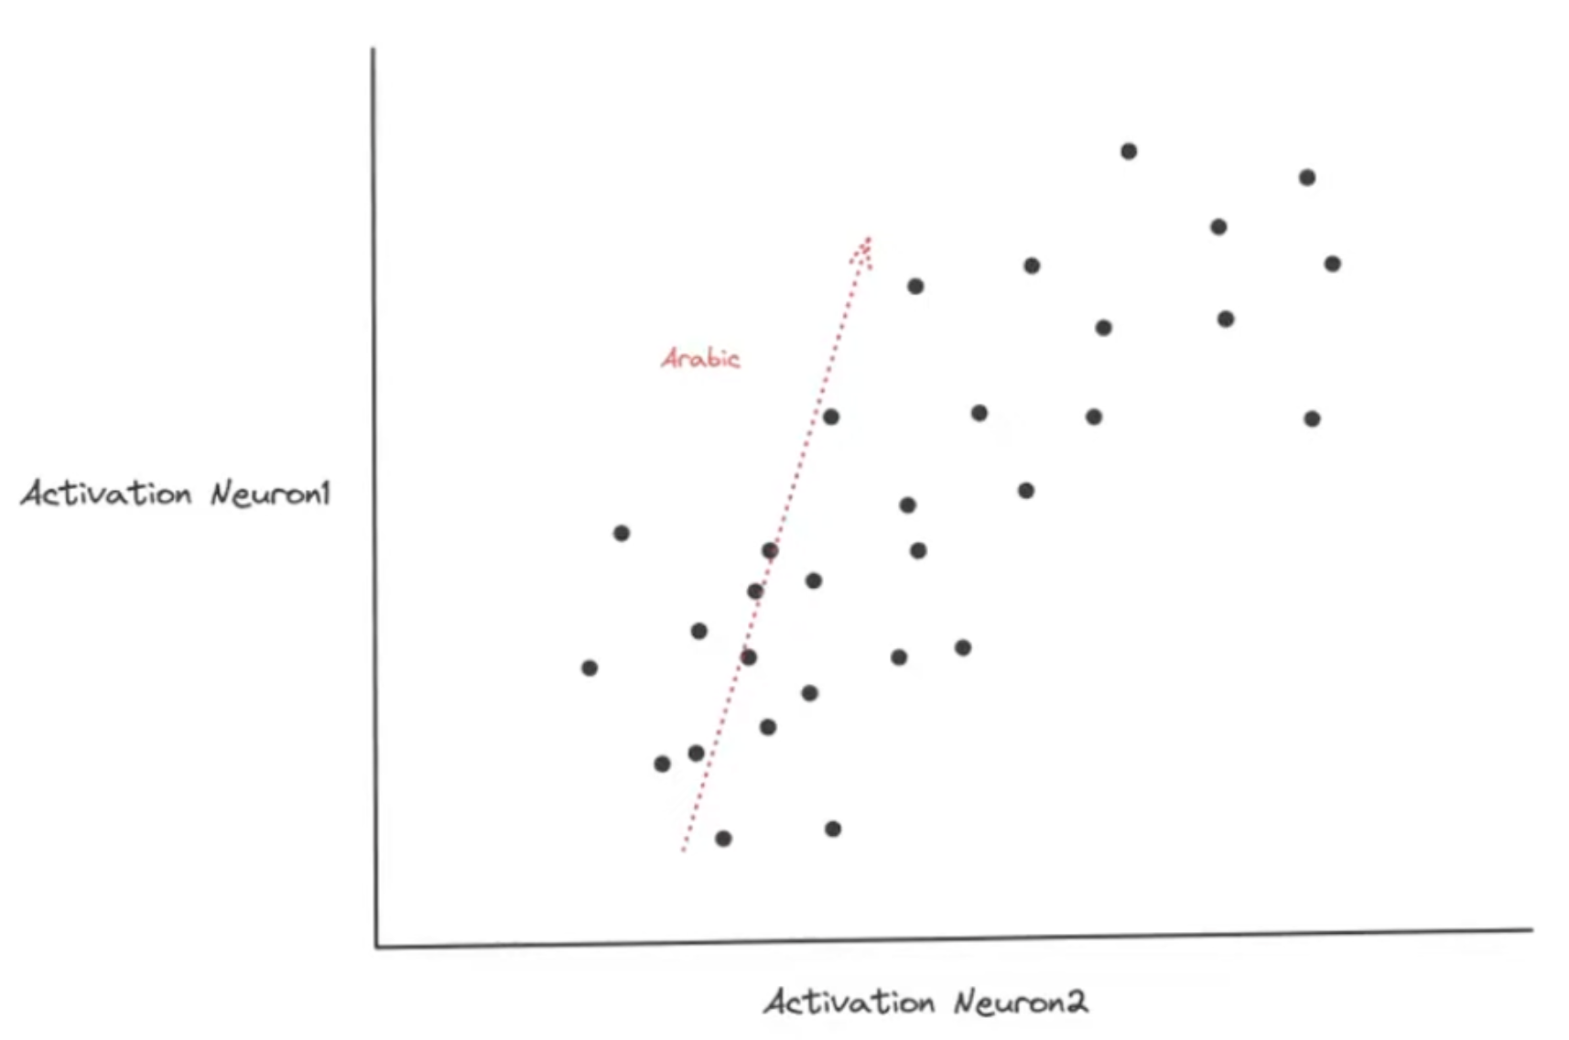
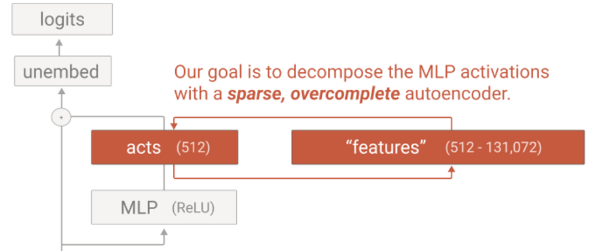
Decomposition: sparse dictionary learning
Suppose that a dictionary exists such that the MLP activation of each datapoint is in fact well approximated by a sparse weighted sum of features.
Notes:
It is kinda a continuation after the paper I talked about just now, where they try to find a direction of neurons, defined as a virtual neuron.
And the dictionary / feature here is also a linear combination of neurons. Here’s a simplified example: if we only look at the correlation of neuron1 and neuron2, we can see that, this direction vector is activated specifically for Arabic scripts.
And according to our superposition hypothesis, we have more features, like Arabic features, or base64 encoding features, or Html code features, than neurons.

Slide 21
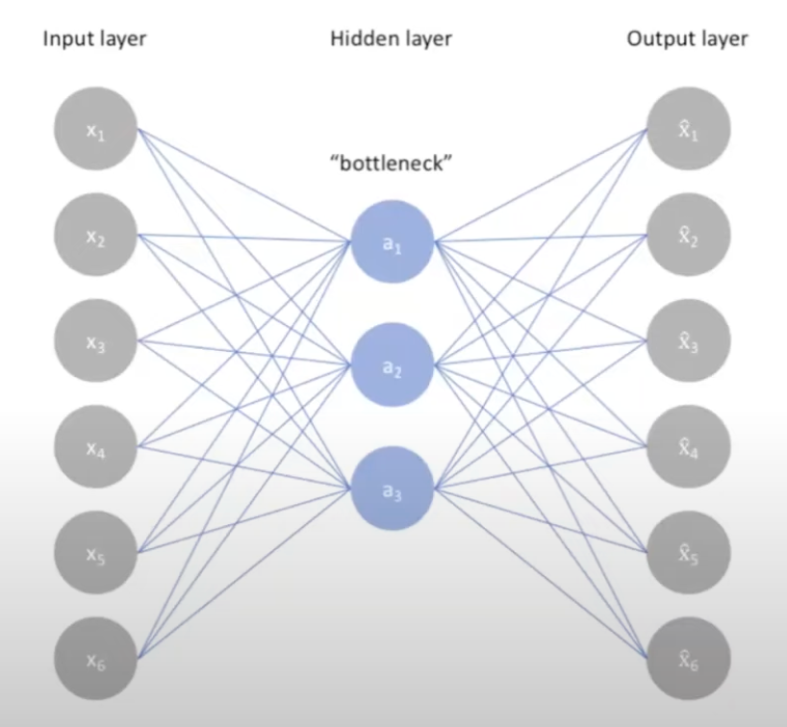
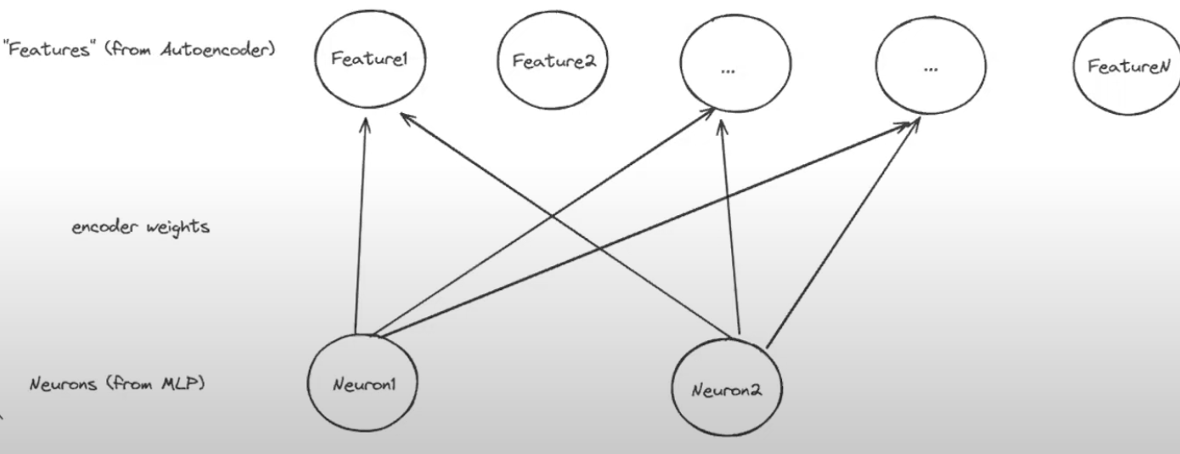
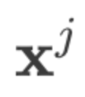
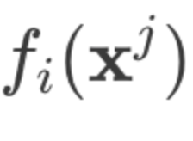
Methods: Set up
Sparse autoencoder: to find a sparse representation such that the data point $x^{j}$ can be reconstructed through the dictionary $D = \{d_{1}, …, d_{n}\}$.
Input layer: adjusted with a bias term
Encoder:
Decoder:
Notes:
We use sparse autoencoder for the dictionary extraction.
Usually, an autoencoder looks like this, where we encode the input data between input layer and hidden layer, and then decode and rebuild the representation between hidden layer and output layer.
And the number of dimension of hidden layer is commonly less than the dimension of input and output layer.
However, in our case, remember that we want to extract an overcomplete and sparse basis as feature. Therefore, the dimension of hidden layer, which is the features here are more than neurons.
The structure of a sparse autoencoder is a simple MLP, where it has
Input layer: take MLP activations from transformers, adjusted with a bias term.
Encoder: A linear layer with bias followed by ReLU activation. where W_e is the weight matrix of the encoder and b_d, b_e are pre-encoder and encoder bias.
Decoder: Another linear layer with bias to reconstruct the input. And the dictionary/feature that we extract is the column vectors of the weight of decoder.

Slide 22
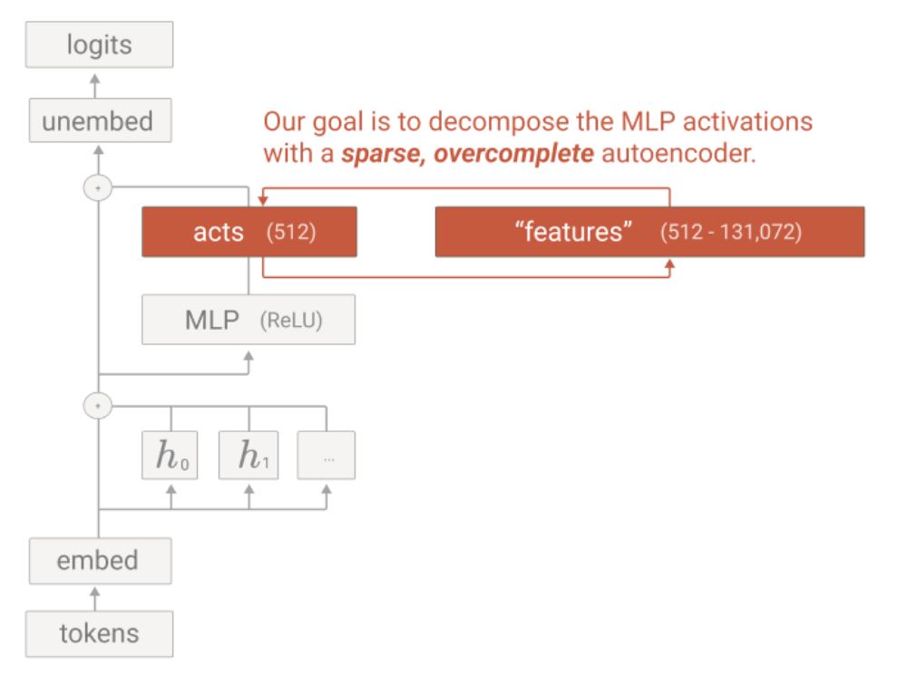
Methods: Set up
Toy model: single-layer Transformer
Fewer true features to capture
Cheaper, simpler
Logit outputs are approximately linear with respect to feature activations.
Data: activations (8 billions of activation vectors) $x$ of MLP layers from the toy model.
Notes:
The subject model that we are trying to explain is a toy model that we have discussed in the previous sessions, which is a single-layer transformer, and its architecture can be seen in this picture. The advantages of using this toy model are, firstly

Slide 23
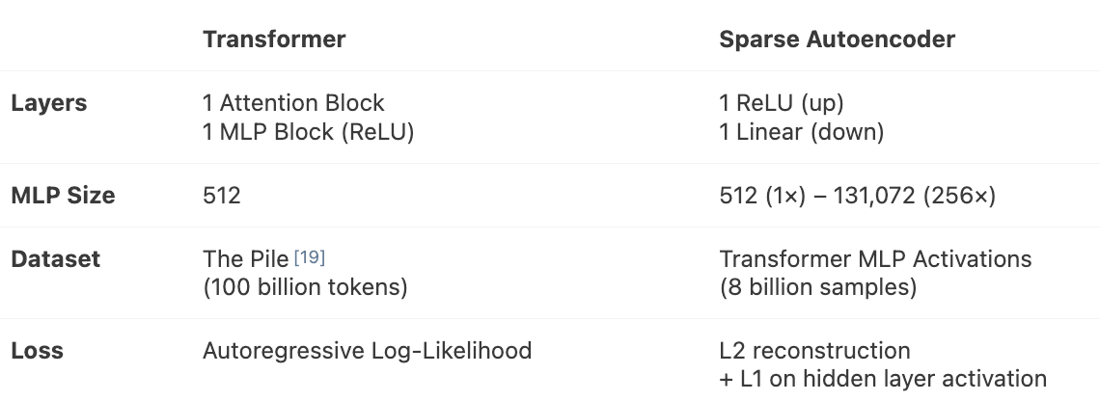
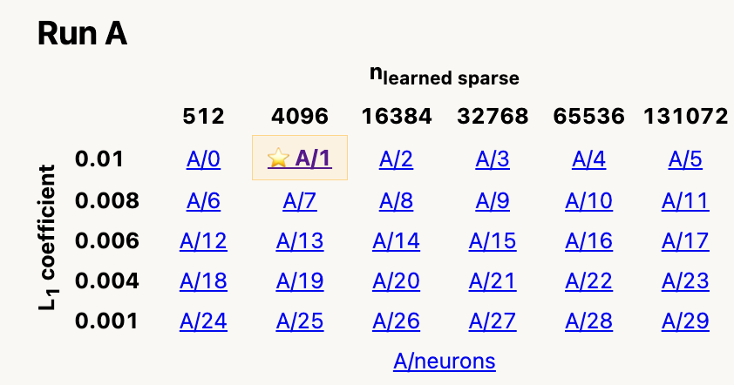
Methods: Set up
Training strategy
"Resampling" dead neurons
Use large scale data
Use toy models that we could determine the ground truth.
Notes:
Here is the overview set up of two models
Training parameters
Loss: MSE with L1 regularization, to enhance sparsity of hidden state
Optimizer: Adam
Mainly focus on expansion factor as 8, which is 4096 features we are going to decompose, and L1 coefficient as 0.01, as shown in this table, the A/1 run
and for the training strategy:
“Resampling” dead neurons：Find dead neurons during training, reinitialize them using inputs with high autoencoder loss, normalize their weights, and reset optimizer parameters to avoid disrupting the network.

Slide 24
Methods: Algorithm
Train autoencoder to get dictionary $D = \{d_{1}, …, d_{n}\}$
Train the autoencoder on activations $x^{j}$
The autoencoder will reconstruct the activations following
By minimizing the MSE of rebuilt activation , we extract the $d_{i}$ of autoencoder as dictionary.
Apply dictionary $D$ for explaining the MLP layer of Transformer
For each token $j$, Transformer produces an activation vector $x^{j}$
Compute activation encoding $f\left(x\right)$ by encoder of sparse autoencoder
Explain activation patterns based on $f\left(x\right).$ The greater the $f_{i}(x)$, the more important the $\text{i}\text{-}\text{th}$ feature $d_{i}$ is.
Evaluate the effect of $f_{i}\left(x\right)$ and to final logits and intermediate representation of Transformer.
Notes:
There are two stages.
Train auto encoder to get dictionary D = \{d_1, ..., d_n\}
train the auto encoder on activations x, where the auto encoder will try to rebuild the activations through higher hidden dimensions.
By minimizing the MSE of rebuilt activation \hat{x} , we extract the d_i of auto encoder as dictionary (a set of combinations of neurons -> features / basis vectors of neurons) the MSE loss here can measure how much the features explain a significant portion of the functionality of the MLP layer.
Apply dictionary for explaing the MLP layer of Transformer
For each token, Transformer produces an activation vector x
Compute activation encoding f(x) by encoder of sparse auto encoder
Where f_i(x) is the activation corresponding to the i-th direction of dictionary d_i
Explain activation patterns based on f(x), the higher the f_i(x), the more important the i-th feature d_i is.
Why? See！ the activation encoding here is served as weights of feature d_i. If the f_i(x) is greater than others significantly , it means, when the sparse auto encoder tries to reconstruct the activation vector x^j, this i-th feature plays an important role in it.
Verify the effect of f_i(x) and \hat{x^j} to final logits and intermediate representation of Transformer.

Slide 25
Methods: Algorithm
$D = \{d_{1}, …, d_{n}\}, n=3$
$d_{1}$: “Bands”
$d_{2}$ : “British culture”
$d_{3}$ : “Royal terms”
$x^{\left\{”Queen”\right\}}= \left[2.1, 0.5, 1.8\right]$
$f\left(x^{\left\{“Queen”\right\}}\right)=W_{e}x^{\left\{”Queen”\right\}}=\left[3.5, 0.1, 1.2\right]$
Notes:
If you still feel confused about it, I have a simple example here.
After training the sparse autoencoder, by minimizing the reconstruction error of rebuilt activation, we extract the Dictionary here, which is actually the column vector of decoder’s weights, every column vector is seen as a feature here.
Let's say the feature dimension is simply set to 3. And feature 1 activates for Bands stuff, and feature 2 and 3 focus on british culture and royal terms respectively.
Assume we input the token “queen”into the Transformer, and this activation vector is what we get from the MLP layer.
Then we input it to the encoder here, like I just said in the last page, the encoding vector f(x) serves as the weights of features.
So we can say that the “Band” feature is strongly activated among all, indicating “Queen” is associated with band.
This is a simple example of the dictionary learning process by the autoencoder, the paper also propose a lot of analysis method after this.

Slide 26
Results: Dictionary learning does work
Sparse autoencoders can…
extract features that are significantly more monosemantic than neurons.
find features that are much more than neurons. 512 neurons $↔$ 10,000 features
discover hidden features that are invisible in the neuron basis.
produce more detailed features with larger model size.
The features…
can be used to control transformer outputs.
are universal across different models.
work like a system to do complex tasks. E.g. generating valid HTML
Notes:
Generally, the conclusions of their results are as follow.

Slide 27
Results: Individual Features
Activation specificity
Downstream effect
Make sure feature is not a single neuron
Universality
Notes:
We are going to see the results from two aspects, firstly we will focus on individual features, and then we will go through the global analysis of general features.
The paper manage to prove this attributes of the features we find with sparse autoencoder, including
There’re so many results in the paper, these are some interesting and basic proof I am going to present.

Slide 28
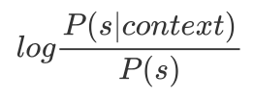
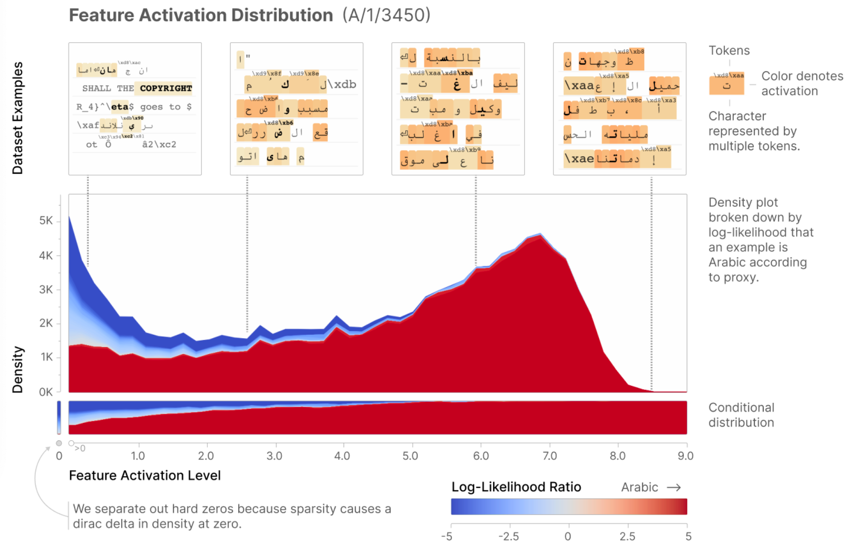
Results: Individual Features – Arabic Scripts
Activation specificity
Measured by computational proxy
Notes:
We take the feature of Arabic scripts as an example,
Firstly, one of the ways to prove this feature is monosemantic is that we define a computational proxy to describe how frequently this feature activates for the hypothesized context, and it’s called activation specificity, following the formula here; in our case ,for Arabic scripts, the context is tokens that belong to Arabic characters.
From this picture, the warmer the colour is, the more frequently the token appears with Arabic context. we can see that generally, this feature activates strongly for those tokens that frequently appear together with other Arabic tokens.

Slide 29
Results: Individual Features – Arabic Scripts
Downstream Effect
Step 1: Start with a known prefix (e.g., “1,2,3,4,5,6,7,8,9,10”) where the model has an expected continuation.
Step 2: Pin the target feature.
Step 3: Sample from the model with the feature pinned at a high value.
Step 4: Compare the output samples to evaluate how the feature affects the model’s behaviour.
Step 5: Validate if the output aligns with the feature’s interpretation (e.g., generating Arabic script).
Notes:
Step 1: Start with a known prefix (e.g., “1,2,3,4,5,6,7,8,9,10”) where the model has an expected continuation.
Step 2: Set the target feature (e.g., A/1/3450) to its maximum observed value (“pin” the activation).
by doing that, we also pin the Samples from the model with the feature at a high value.
Step 4: Compare the output samples to evaluate how the feature affects the model’s behavior.
Step 5: Validate if the output aligns with the feature’s interpretation (e.g., generating Arabic script).
From the pic, normally it predicts these tokens, but if we pin the target feature, the model tends of predict arabic tokens.

Slide 30
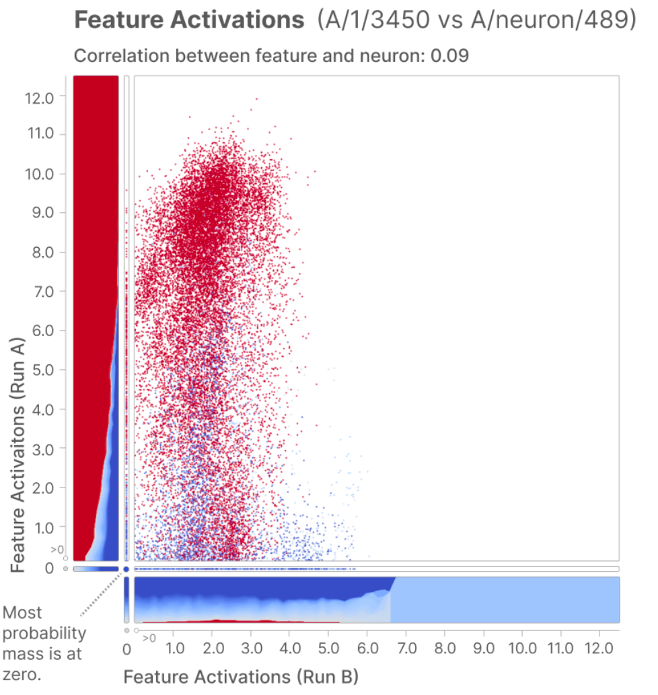
Results: Individual Features – Arabic Scripts
The learned feature does not correspond to any neuron.
Notes:
They also prove that The feature is not a single neuron, but comes from multiple neurons’ combination
In particular, note how the y-axis here corresponds to the feature, while x-axis corresponds to the neurons. And the feature can cleanly separate the Arabic script token logits, while the neuron does not.

Slide 31
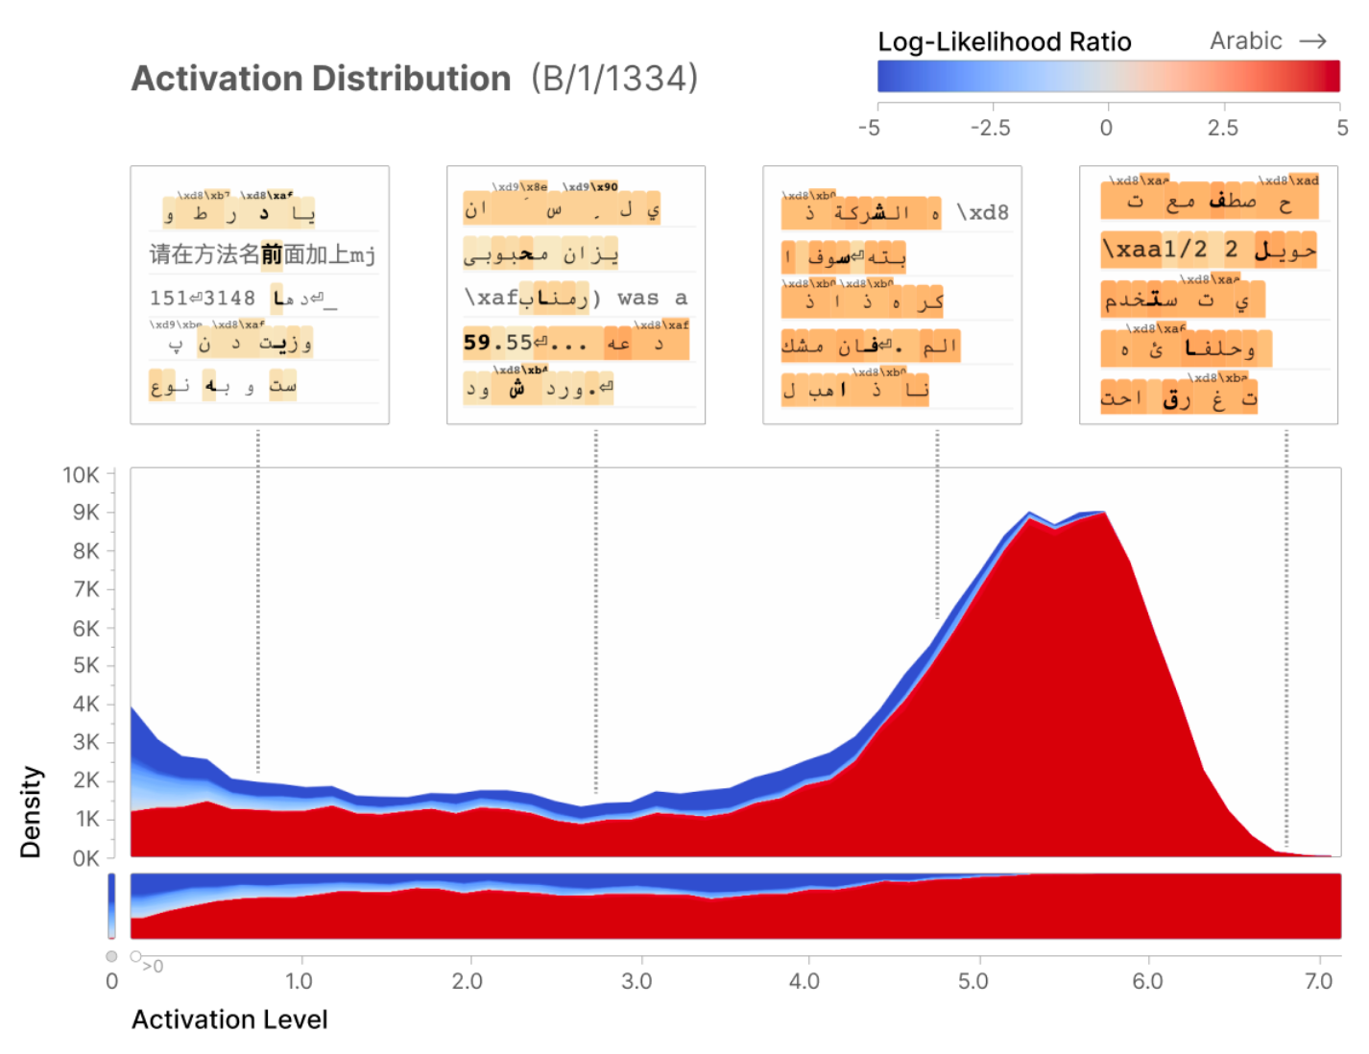
Results: Individual Features – Arabic Scripts
Universality
B is another Transformer trained in controlled condition compared to A,
Notes:
They also prove that the feature is universal.
B is another Transformer trained under controlled condition compared to A,
like we use same dataset and parameters to train another Transformer B,
and we could also find an Arabic feature in B, and it has similar patterns, like activation specificity.

Slide 32
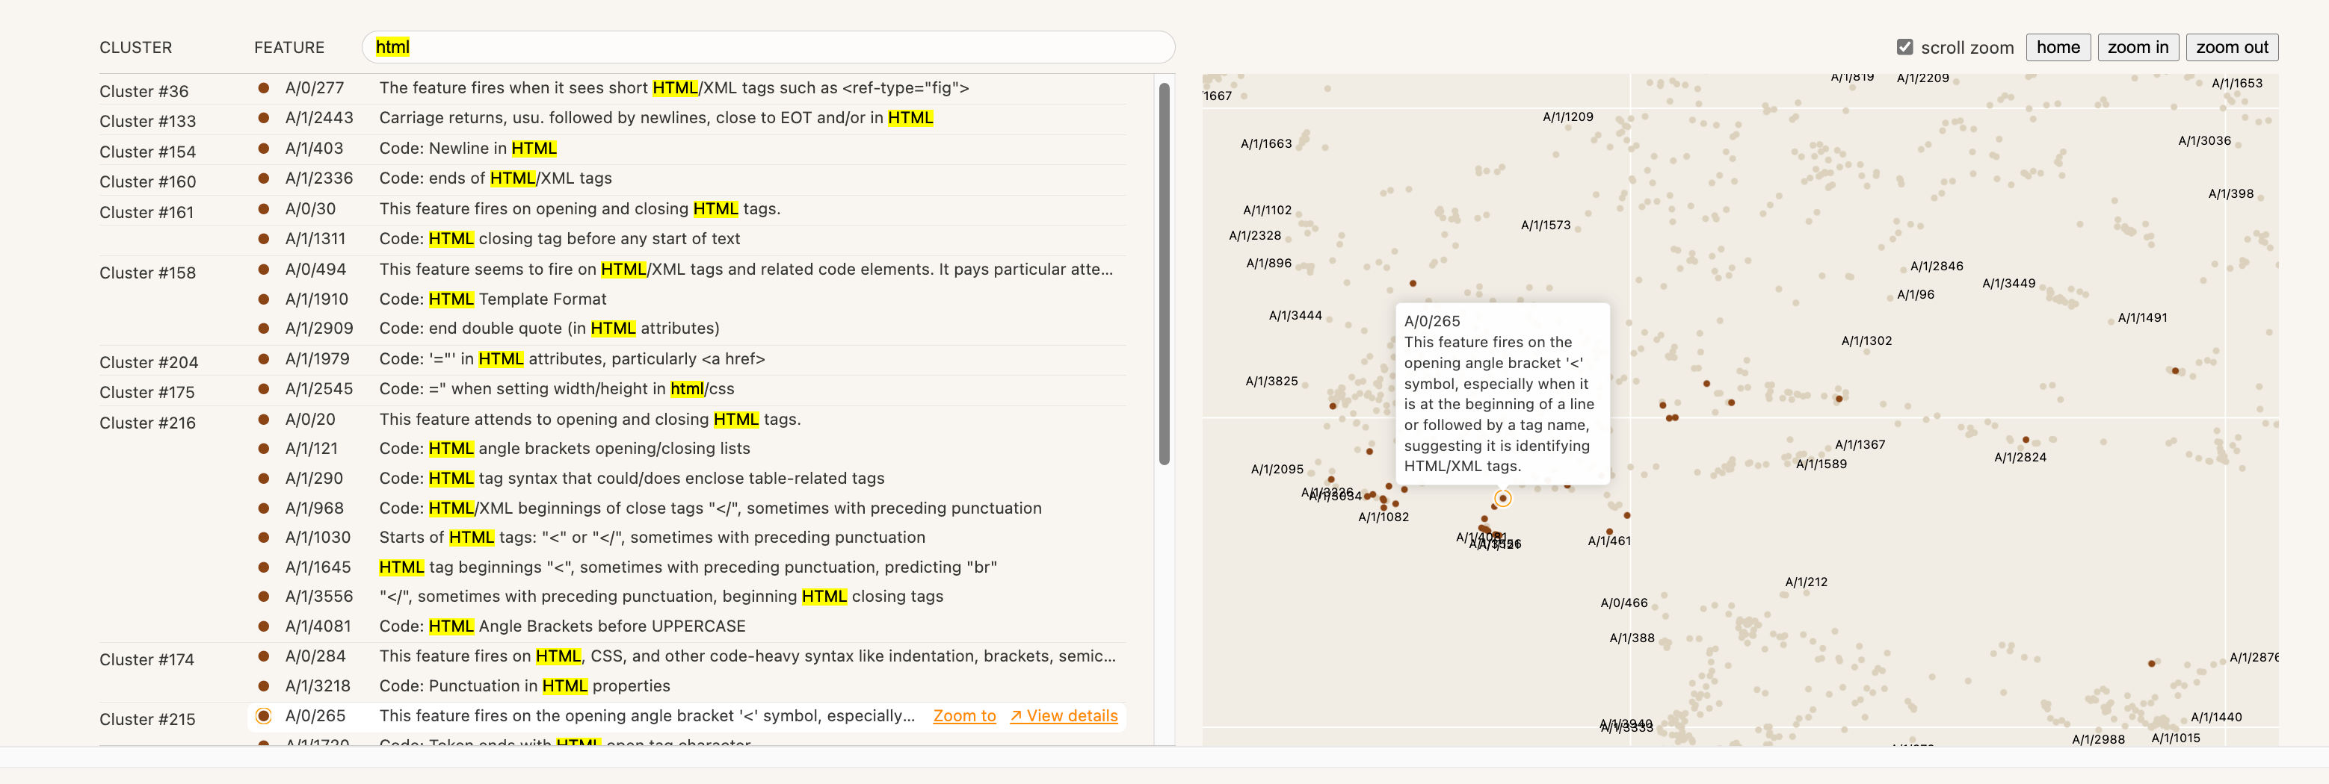
Results: Individual Features – HTML
Features collaborate as a system
Notes:
Another interesting phenomenon is that features collaborate as a system
Let's take HTML feature as an example.
We can see that different features play a specific part of it when generating HTML code.
And they are somehow close after reducing dimensions, in terms of their spatial information. We can see this point from this map. Where the html features stick together as a cluster.

Slide 33
Results: Individual Features – HTML
Features collaborate as a Finite-State Automata
A/0/20: Fires on opening tags, predicts tag names (e.g., <div).
A/0/0: Fires on tag names, predicts tag closures (e.g., >).
A/0/30: Fires on tag closures, predicts whitespace (e.g., \n, \t).
A/0/494: Fires on whitespace, predicts new tag openings (e.g., <).
Notes:
And the system here can actually be a Finite state automata.
What they find is a 4 node FSA, where we have features
And we can see that some of them has their own clusters to get the job done, like a department in an organization

Slide 34
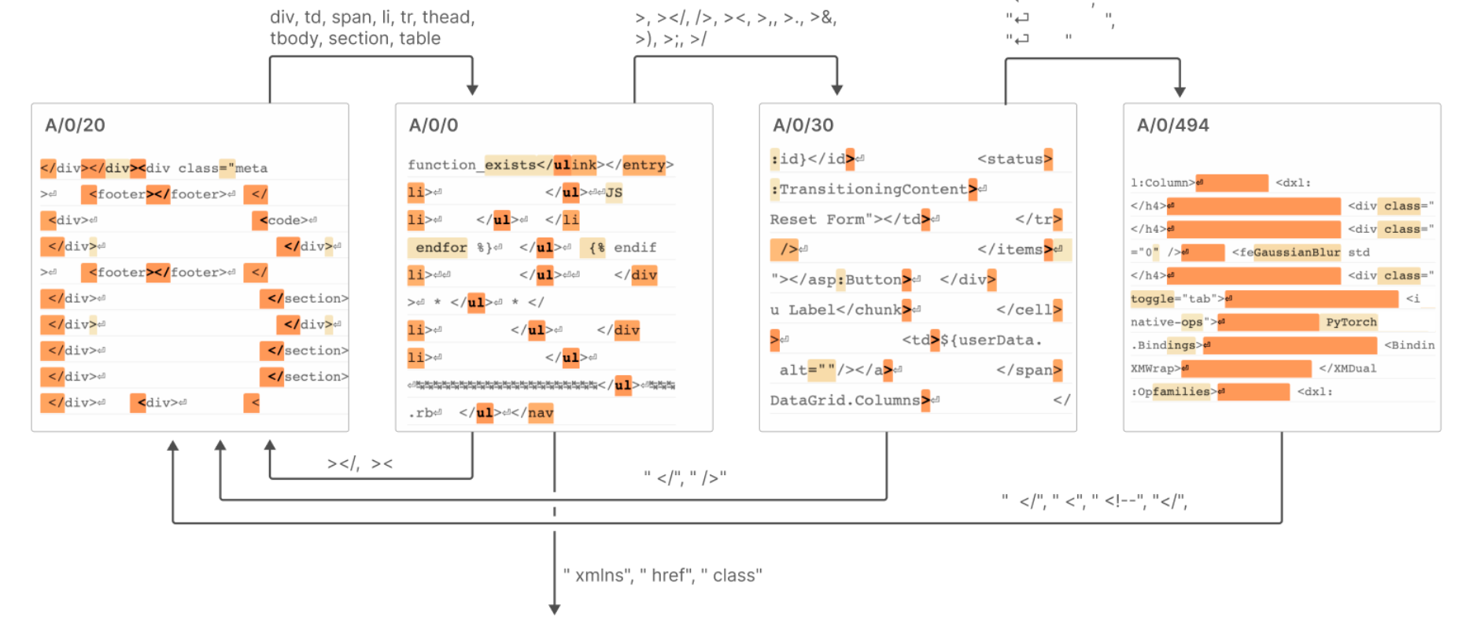
Results: Individual Features – HTML
Features collaborate as a Finite-State Automata
1. Start with <div (A/0/20).
2. Close the tag with > (A/0/0).
3. Add whitespace or newline \n\t (A/0/30).
4. Open new tag <span (A/0/494).
Notes:
Here is the illustration of how this FSA works
start with open tag, firing by this feature
close tag
add whitespaces or new line
open new tag

Slide 35
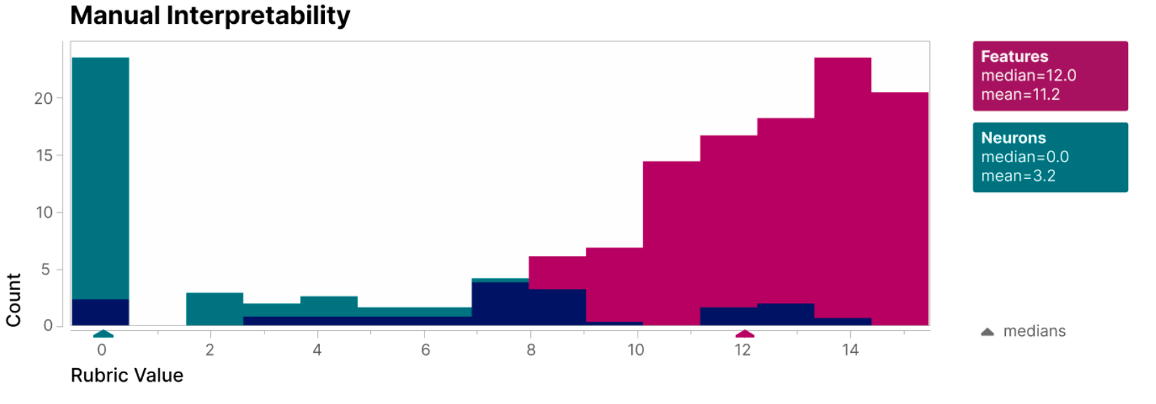
Results: General Features
How interpretable are the rest of the features?
Manual Analysis
412 feature activation intervals were scored across 162 features and neurons.
We see that features are substantially more interpretable than neurons.
Notes:
As for the general features, one important question is : How interpretable are the rest of the features.
The paper use manual analysis, and we can see that features are substantially more interpretable than neurons.

Slide 36
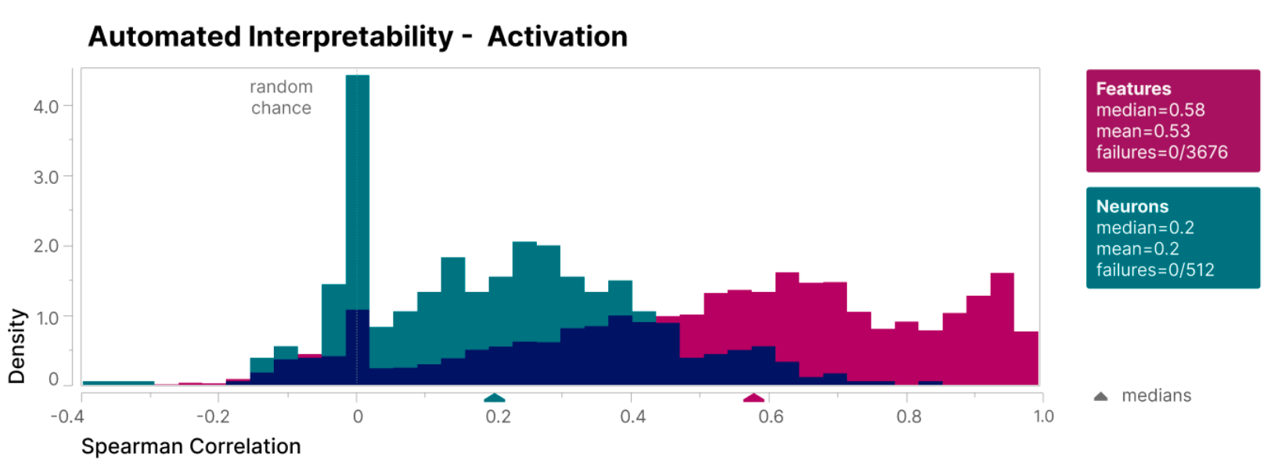
Results: General Features
Automated Interpretability – Activations [Bills(2023)]
Use Anthropic’s Claude to generate explanations of features using examples of tokens where they activate.
Simulate new activations on previously unseen token with Claude on its explanation.
Compute the Spearman correlation coefficient between predicted activation and true activations.
[Improved] Draw samples uniformly across the spectrum of feature activations, while Bill's method focus only on the regions with higher activations
Notes:
And the second analysis method this paper use comes from the Automation method from the first paper that we just talk about
explain, simulate, and evaluate
Many polysemantic neurons appear monosemantic if you only look at top dataset examples, but are revealed to be polysemantic if you look at lower parts of the activation spectrum. They find that features are more monosemantic and explain better than neurons

Slide 37
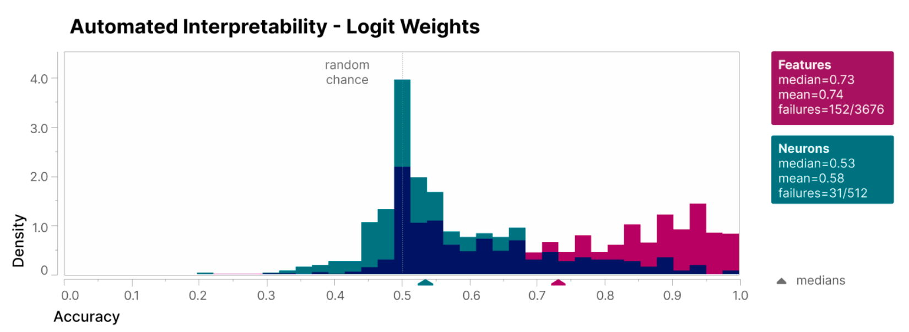
Results: General Features
Automated Interpretability – Logits Weights
Use Claude to generate explanations of features.
Use these explanations to predict whether an unseen logit token is likely to be associated with a feature.
Compare the predictions against a test set of logit tokens.
Evaluate the accuracy of predictions; a random baseline achieves 50%, while the method achieves significantly higher accuracy (74%).
Notes:
This method is similar with last one, except that it focus on logits weights
Use Anthropic’s Claude to generate explanations of features using examples of tokens where they activate.
Use these explanations to predict whether an unseen logit token is likely to be associated with a feature.
Compare the predictions against a test set of logit tokens, consisting of a 50/50 mix of high-positive logit tokens and random tokens.
Evaluate the accuracy of predictions; a random baseline achieves 50%, while the method achieves significantly higher accuracy (e.g., 74%).

Slide 38
Results: General Features
Automated Interpretability – Logits Weights
Example: Suppose we are looking at a feature that activates for tokens like “Suede”, “Oasis”, “Libertines”
Explanation: This feature relates to some names of Britpop bands.
Predict whether unseen logit tokens like “Slowdive”, “Pulp”, or “Boygenius” are likely to be associated with the feature.
Compare predictions and evaluate accuracy.
Notes:
Here is an example of the automation for logit weights
Suppose we are looking at a feature that activates for tokens like “suede”, “oasis”, “Libertines”
1. Step 1 - Generate explanations:
Use Claude to generate the explanation: This feature relates to some names of Britpop bands
2. Step 2 - Predict unseen logits:
Predict whether unseen logit tokens like “Slowdive”, “Pulp”, or “Boygenius” are likely to be associated with the feature.
3. Step 3 - Compare predictions:
• Positive logits include tokens like “Pulp” which is a britpop band
• Random logits include unrelated tokens like “Boygenius.” bc it has no relation to britpop at all, it's an indie rock band from America.
4. Step 4 - Evaluate accuracy:
If predictions correctly associate “Pulp” with the feature and reject unrelated logits like “boygenius,” the accuracy will surpass the random baseline (50%)

Slide 39
Results: Reconstruction Loss
How much of the model does our interpretation explain?
Feature-based interpretation explains 79% of MLP loss reduction (A/1) and up to 94.5% with larger dictionaries (A/5).
Limitations of this metric
Features may not be fully monosemantic, and low activations might hide polysemanticity.
Current methods are computationally expensive and lack efficient metrics for deeper analysis.
Notes:
It means we can reconstruct 79% of MLP activation using the trained sparse autoencoder

Slide 40
04
Sources

Slide 41
Sources
What “Dictionary Learning” actually is? [https://medium.com/analytics-vidhya/what-dictionary-learning-actually-is-812d264e9646]
Towards Monosemanticity: Decomposing Language Models Into Understandable Components - Arize AI [https://www.youtube.com/watch?v=hlCxSqWS6Rw&t=54s]
Language models can explain neurons in language models
Towards Monosemanticity: Decomposing Language Models With Dictionary Learning

Slide 42
05
Discussion

Slide 43
Discussion
Questions for the Bills et al. (2023):
Can neurons identified as responsible for specific concepts in one model be reliably used to predict similar functionality in another model with a different architecture or training dataset?
Questions for the Bricken et al. (2023):
How should the expansion factor (e.g., 1× to 256× as mentioned in the paper) be selected for feature decomposition to balance sparsity and information retention?
Notes:
I think this is quite challenging, because based on the results of the second paper, we can see that neurons usually don’t work on their own. Due to the superposition, it’s hard to generalize the role of certain neuron in one model to another. Though, I still think this concept is interesting, that the neurons, or features that we discover can be moved as a component of a mechanistic system. If this works, we can do a lot task-specific or domain-specific research with it.
Question 2
The paper lack a detailed comparison experiment of this expansion factor
According to the Future work section, It’s one of their next steps.
But what we can know intuitively is
Smaller factors (like 1×) make features sparser but may miss complex patterns.
Larger factors (like 256×) capture finer details but risk redundancy or overfitting. It also has higher reconstruction rate, compared to smaller factors, according to the results about reconstruction loss.
And we could choose it based on specific task needs and data distribution

Slide 44
Thanks!

