Slide 1
INTERPRETABILITY IN THE WILD: A CIRCUIT FOR INDIRECT OBJECT IDENTIFICATION IN GPT-2 SMALL
Towards Automated Circuit Discovery
for Mechanistic Interpretability

Slide 2
Content
Introduction to Mechanistic Interpretability
Overview of the Indirect Object Identification (IOI) Task
GPT-2 Architecture and Circuit Analysis
Methodology for Circuit Discovery
Key Findings: Circuit Components and Functions
Validation of the Circuit Explanation
Limitations and Future Work
Conclusion and Implications

Slide 3
Introduction to Mechanistic Interpretability
Model
Computational Graph
Pipeline & workflow
Task (6 common tasks,IOI, Greater than )
Dataset (Promtps -> elict behavior & task)
metric (measure the extent of behavior)
-------------------------------------------------------------
Level of granularity
-------------------------------------------------------------
Patching experiment iterately (zero & corrupted activation)
Cirsut
S1
Attentio heads
MLP layers
neuros
S2
Node ‘s conception
S3
ACDC to automate the step 3

Slide 4
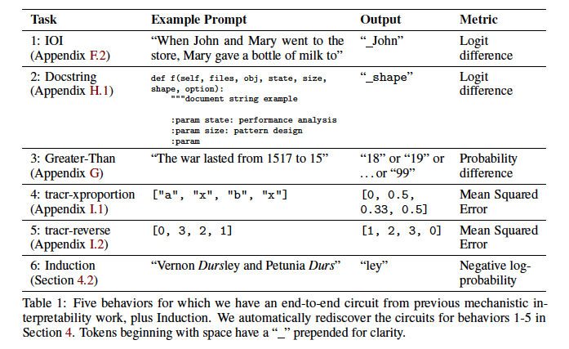
Task & behavior

Slide 5
Overview of the Indirect Object Identification (IOI) Task
Task -> IOI (indirect object indentification)
Dataset -> prompts generated from templates(Pioi and PABC)
Metric -> logit different between (IOI – S and IO probability
------------------------------------------------------------------------------------------
Granularity -> attention head(s)
------------------------------------------------------------------------------------------
Pathing experiment(manully without ACDC)

Slide 6
TASK : IOI(indirect object identification)
Definition:
Predicts the correct indirect object in a sentence
(e.g., in "John gave a drink to Mary", "Mary" is the IO).
Example Task:
- Sentence: “When Mary and John went to the store, John gave a drink to __.”
- Desired Prediction: “Mary” (the indirect object).

Slide 7
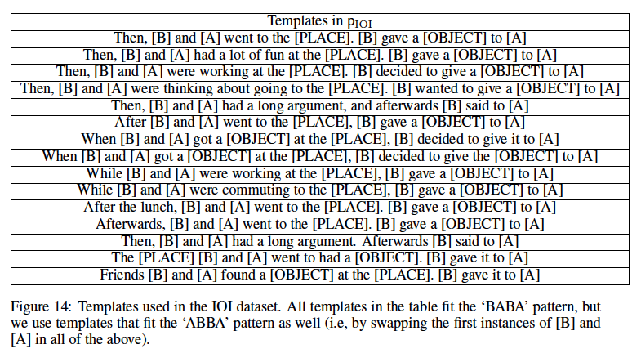
Dataset(prompts)

Slide 8
Metric
 | Avg. over 10,000 examples
Logit difference | 3.56 | IO predicted over S 99.3% of the time)
IO probability | 49%
Performance of GPT2-small on the task IOI

Slide 9
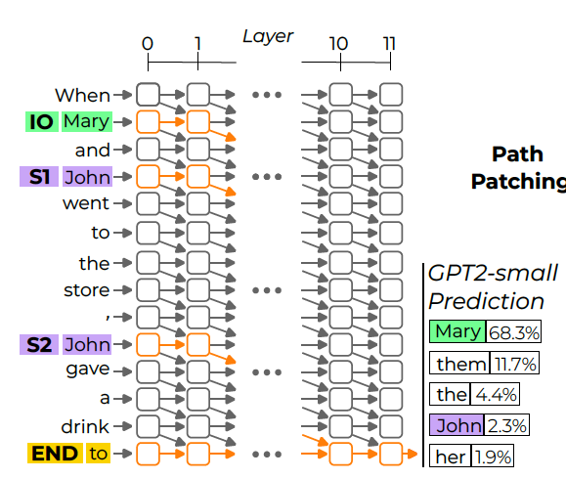
GPT-2 Architecture and Circuit Analysis
Structure:
- 12 layers with 12 attention heads per layer.
- Decoder-only model focused on autoregressive language generation.
Residual Streams:
- Attention heads and MLPs contribute to these streams,
combining input and layer outputs.
Circuit Definition:
- A subgraph of the model responsible for a specific behavior
(here, IOI task).
Knockout(nodes) Experiments:
Removing components to identify those essential
for task execution

Slide 10
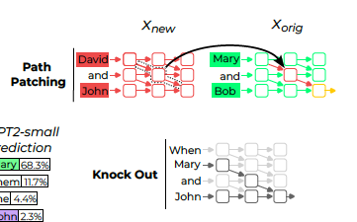
Methodology for Circuit Discovery
naive :Zero ablation: 0 is an arbitrary value,
an implicit bias term lead to noisy results
in practice.
Mean ablation : replacing them with their
average activation value across some
reference distribution, preserve the
constant information(the output is
the name)
Path patching:
To differentiate indirect effect (where the influence of a component is mediated
by another head) from direct effect

Slide 11
PABC distribution
Three random and unrelated names -> IO & S(A and B)
Grammer structure is the same as that in PIOI
Remove much more information(keep the grammer structure.)
Mean cross the samples of the same template
(20 templates, grammer role varies across templates )

Slide 12
Key Findings: Circuit Components and Functions
Human interpretable algorithm
1. Identify all previous names in the sentence.
2. Remove all names that are duplicated.
3. Output the remaining name.
When Mary and John went to the store, John gave a drink to _
(Mary).
(Mary, John, John).

Slide 13
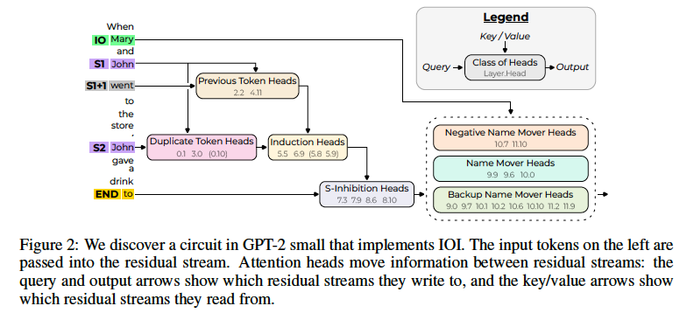
Key Findings: Circuit Components and Functions
26 heads
7 classes

Slide 14
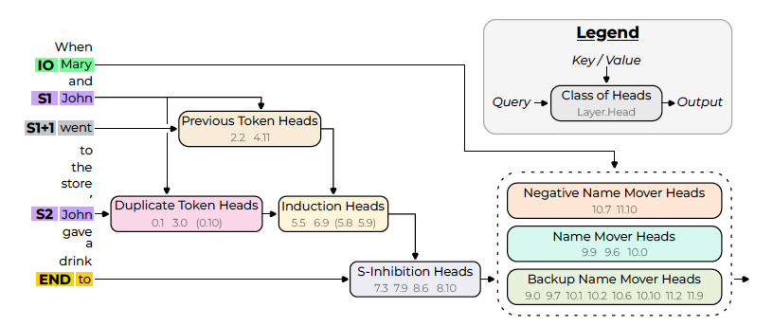
Identified Circuit Components-3 major heads
Duplicate Token Heads
identify tokens that have already appeared in the sentence
attend primarily to the S1 token from S2
Write the duplication tokens’ position
S-Inhibition Heads
remove duplicate tokens from Name Mover Heads’ attention
Active at the END token attend to the S2 token

Slide 15
Identified Circuit Components
Name Mover Heads
output the remaining name
Active at END
Attend to IO token over S1 and S2 (S-inhibition)

Slide 16
Identified Circuit Components
Negative Name Mover Heads
writes in the opposite direction of the Name Mover Heads
to avoid high cross-entropy loss when making mistakes

Slide 17
Identified Circuit Components-3 minor heads
Previous Token Heads
copy information about the token S to token S1+1
Backup Name Mover Heads
move the IO token to the output(regular Name Mover Heads are knocked out
Induction Heads
perform the same role as the Duplicate Token Heads through an induction mechanism.
active at position S2, attend to token S1+1
used both as a pointer to S1 and as a signal that S is duplicated

Slide 18
The way to discover each of the seven components
to uncover the circuit starting at the logits and working back step-by-step
For each step:
do :
1. trace the information flow backward from previously discovered components
(equivalent to finding attention heads that directly influence them) → path patching
2. characterize the newly identified heads(examining their attention patterns)
end
End
Notes:
to uncover the circuit starting at the logits and working back step-by-step

Slide 19
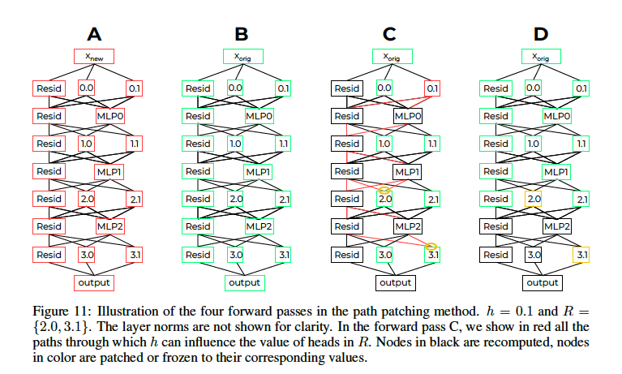
to uncover the circuit starting at the logit(output)
Path patching in detail
Node: fixed attenion head h
P : all direct path from h to a set of component R
paths through residual connections
and MLPs (but not through
other attention heads)
Patching the receiver nodes
Logit difference
a measure
of the importance of the path h -> r

Slide 20
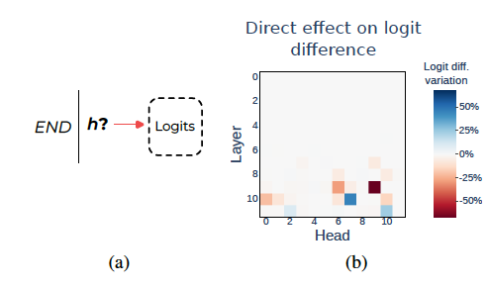
Name mover heads
Functions: directly affecting the model’s logits
Path patching : h → Logits (for each head at the END position)
Display the effenct on logit difference(increase or decrease)
Large drop & decrease:
(Positively)
Node:9.6
Node:9.9
Node:10.0
Large increase:
(Negatively)
Node:10.7
Node:11.10

Slide 21
Name mover heads
IOI and S1 went to the [PLACE]. S2 gave a [OBJECT] to IOI
Study the attention pattern
IOI
and
S1
went
to
the
[PLACE]
S2
gave
a
[OBJECT]
to
IOI
Hypothesis
1. attend to the correct name
2.copy whatever they attend to.
Name mover heads
0.59 0.01 0.08 x x x x.x x.x x x x x x.x x

Slide 22
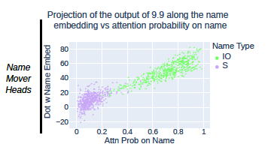
Name mover heads
Verify the hypothesis
1. attend to the correct name
2.copy whatever they attend to.
W_u: unembedding vecgtor
V_ioi = W_u[IO]
V_s. = W_u[S]
Project head output hi(X) along the Unembedding vevtor
OV[]:the OV matrix of a Name Mover Head
Attend to each name token 100% by directly multiply the output from the residual stream after the frst MLP layer
Copy score: Top 5 logits contain the N.
95% copy socre for Name mover head
(correlation > 0:81, N = 500)

Slide 23
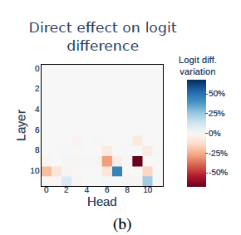
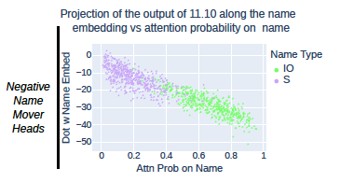
Negative name mover heads
Share the same property as name mover heads
Write in the opposite direction of of the names they attend to
Negative copy score
Node: 10.7 & 11.10

Slide 24
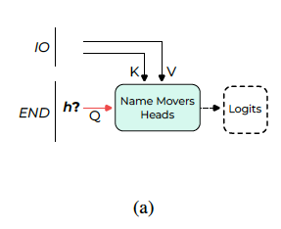
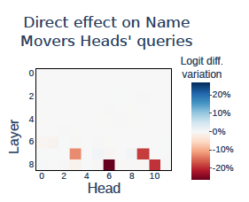
S-INHIBITION HEADS
Functions: AFFECT THE NAME MOVER HEADS’ ATTENTION
Path pathing agagin：h → query of Name mover heads
Display the effect on logit difference(increase or decrease)

Slide 25
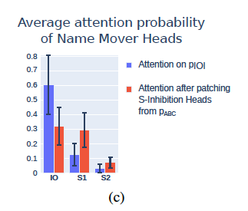
S-INHIBITION HEADS
average attention from END to S2 was 0.51 over the four heads
C:move information about S that causes Name Movers to attend less to S
token signal : contains the value of the token S
→ causes Name M.Hs. to avoid occurrences of that token
position signal : contains information about the position of the S1 token
→ cause Name M.Hs. to avoid the S1 position
To decrease attention to S1.
Disentangle two signals
position signals have a greater effect than token signals
Notes:
Two ways through which S_inhigition head do it

Slide 26
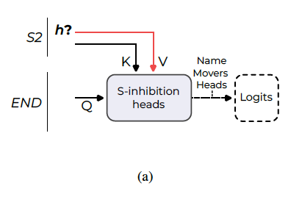
S-INHIBITION VALUES(who affects S-I V.? )
Path patching : h → {queries, keys, values}
Values: the most important
Queries: no significant effect
Path : h → S-Ingibition heads values
Recompute the value on the indirect line
Diagram of the direct effect experiment on S-Inhibition Heads values

Slide 27
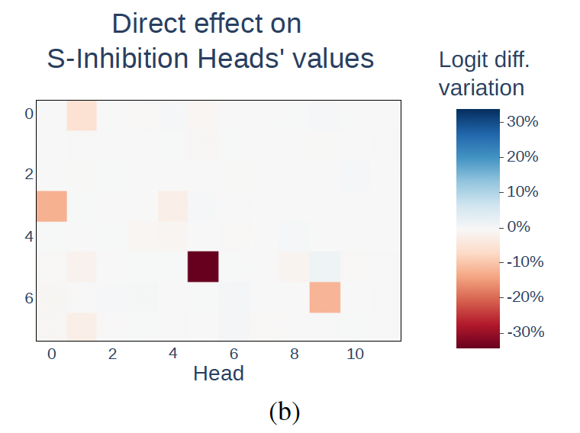
S-INHIBITION VALUES
Path : h → S-Ingibition heads values
Head 3.0
Head 0.1
Head 5.5
Head 6.9
S2 -> S1
S2->S1+1
S2 -> S1 : Two Duplicate Token Heads.
attend to the previous occurrence of a duplicate token
copy the position of this previous occurrence to the current position
S2-> S1 +1 Induction Heads
act in pairs with Previous Token Heads(copy info. about S1 to S1+1)

Slide 28
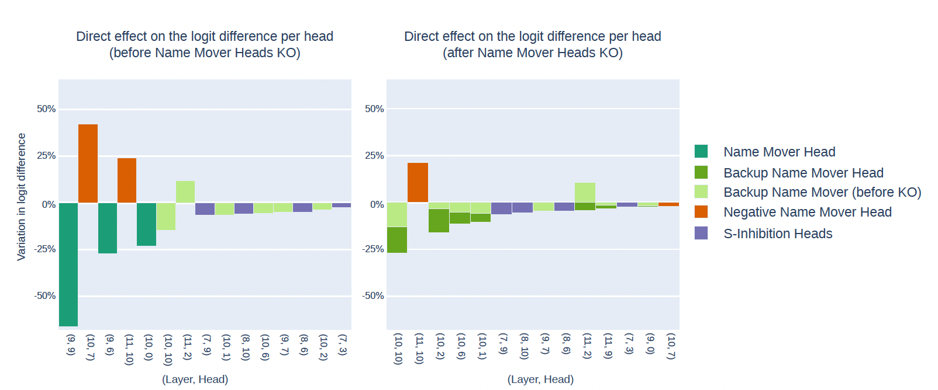
Backup Name movers heads
1.knocked out all the Name Mover Heads at once.
2.circuit still worked (only 5% drop in logit difference)
3.Identify new heads (backup Name movers heads) by path patching
Reason : Dropout

Slide 29
Validation
Validation Criteria
Faithfulness: - The circuit should perform as effectively as the full model.
Completeness: - All necessary components should be present within the circuit.
Minimality: - Only essential components are included, with no irrelevant nodes.

Slide 30
Pipeline & workflow
Task (6 common tasks,IOI, Greater than )
Dataset (Promtps -> elict behavior & task)
metirc (measutre the extent of behavior)
-------------------------------------------------------------
Level of granulairty
-------------------------------------------------------------
Patching experiment iteratey (zero & corrupted activation)
Attentio heads
MLP layers
neuros
Node ‘s conception
ACDC: Automatic Circuit DisCovery

Slide 31
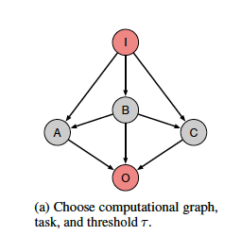
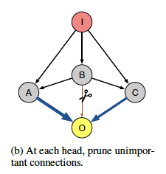
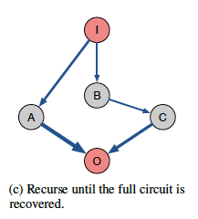
ACDC:Automate Circuit DisCovery
How ACDC works
Dataset:
${{(x}_{i})}_{i=1}^{n}$: task-related data
${(x_{i}^{′})}_{i=1}^{n}$ : coruppted activatioin

Slide 32
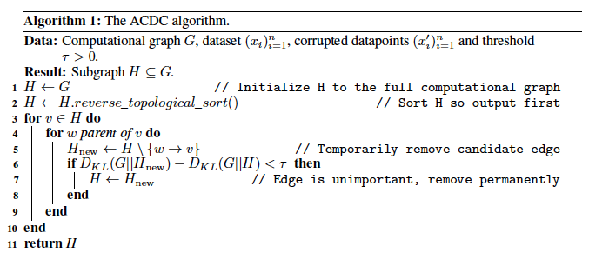
ACDC:Automate Circuit DisCovery
Formalize ACDC

Slide 33
Subnetwork Probing & Head Importance Score for Pruning
Learn a mask over internal components(MLP, attention heads)
Round to 0 or 1
Masked components corespond to subnetwork.
Accuracy & Sparsity (tradeoff → Lamda Hyperparameter)
Retain enough information (linear probe still works)
ranks the heads by importance scores
prunes all the heads except those with the top k scores
(keep only k heads)

Slide 34
Evaluation of Subgraph Recovery Algorithms
Q1: Does the method identify the subgraph corresponding to the underlying algorithm
implemented by the neural network? TPR(True positive rate) ->high
• Q2: Does the method avoid including components which do not participate in the elicited
behavior? FPR(False positive rate)-> low
Area under ROC

Slide 35
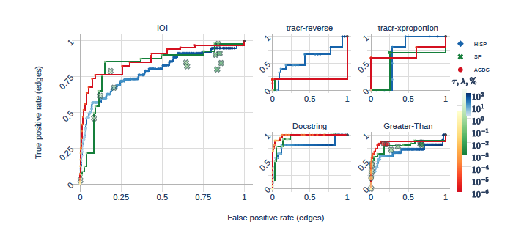
Compare HISP, SP, ACDC
Notes:
Figure 3: ROC curves of ACDC, SP and HISP identifying model components from previous work,
across 5 circuits in transformers. The points on the plot are cases where SP and ACDC return
subgraphs that are not on the Pareto frontier.

Slide 36
Q & A

Slide 37
1. Wang et al. (2022): The paper describes an iterative method for discovering circuits. Could you clarify how, in practice, the stopping point for iterations is determined—i.e., when a circuit is considered sufficiently identified? The authors categorize 26 attention heads into 7 main categories. Could you elaborate on the criteria or characteristics used for these categorizations? Is there a possibility of crossover or overlap, where some heads might belong to more than one category? 2. Conmy et al. (2023): The ACDC algorithm utilizes the parameter τ to decide whether to remove connections. How is this parameter selected, and how does varying it affect the outcome of circuit discovery? I am wondering if there are potential improvements to the ACDC algorithm that could help identify and interpret the role of any negative components in the circuits.

Slide 38
for Wang et al. (2022): 1. Are negative heads reducing privileged bases? 2. The finding that the impact of an earlier-layer head might be seen through its influence on a later-layer head rather than directly on the output(indirect effects) seems to be consistent with the finding in the previous topic, that, earlier-layer nodes are more of polysemantic neurons? for Conmy et al. (2023): 1. Is there already some circuits' identification and isolation in the formalism of directed acyclic graph (DAG) itself? 2. What is the benefit of the activation patching intervening on the edges, not directly on the nodes?

Slide 39
1.Can we expect to see a similar distribution dispersed in the lower attention probabilities (Fig. 3c Purple in upper graph) for Name Type IO when examining IO in "average heads", since " All three Name Mover Heads have a copy score above 95%, compared to less than 20% for an average head.”
2. Might the positional embedding and unboundedness to grammaticality make the Docstring task perform better using the same Logit Difference metric, since Docstrings generally follow the order of parameter mentions as compared to the IOI task.

Slide 40
(Conmy et al. 2023): The authors are very transparent about the limitations of the algorithms. However, coming from the IOI-Paper, I think Conmy et al. do not highlight enough that they indeed have a very high precision rate of recovered heads (9/9), but a very poor recall rate (9/26); it's not just the "negative components" they miss. Yes, the "ground-truth" circuit by Wang et al. is by no means perfect. In addition, it is probably better to think about finding circuits more in terms of PCA, where you almost always have to accept some loss. Nevertheless, I think this should be highlighted.
I have some issues with the way the algorithms cut nodes, only measuring the effect of a single node being removed/ablated. Conmy et at al. address this partly in Appendix M and when answering Q2 more generally; the minimalism property of circuits.
Let's say two node depend on each other, but cancel each other out. They are independent of the rest of the circuit. The "remove-only-one-node algorithms" wouldn't remove those two nodes, infringing on the minimalism objective. Do you think it is worthwhile to also consider pairs/sets of nodes being measured and then kept/removed? Computational complexity would rise sharply but I think by also implementing some constraints, this approach would improve ACDC instantly.

Slide 41
Questions and comments for “Interpretability in the wild: a circuit for indirect object indentification in GPT-2 small”: The paper made efforts in mechanistically understand how GPT2-small by focusing on the IOI task. And they had discovered several components by using the technique path patching, among which i am curious about the backup Name Movers heads. The authors knocked out the name movers head but found the circuit still working with these Name Movers heads, which changed the behaviors of other heads, what if these changed heads are originally S-Inhibition heads, induction heads, etc? Will they still act as their original role or just act as backup movers heads or both? If they just act as backup movers heads, then what nodes will act as their original roles, do we also have backup S-inhbition, induction heads? This paper mainly focus on the simple IOI tasks, but if we feed the circuits with more complicated tasks, such as inference, summarization, etc. These tasks cannot be done by only moving or copying information from the previous sentence. What will the components probably deal with these tasks, or if i can say for example, moving the name is just a subset of the abilities of the name movers heads, but actually they can perform more tasks than they are discovered? Questions and comments for “Towards Automated Circuit Discovery for machanistic interpreterbility”: ACDC remove the edges that enter the nodes, so can we apply it to pratical application, for example, could ACDC identify unintended or emergent behaviors within language models? Would itbe able to reveal circuits involved in undesirable behaviors such as biases or toxicity, and could it help create mechanisms to disable these circuits? The paper noticed that the behaviors of ACDC and SP is very sensitive to hyperparameter and metricc choice, thus leads to varied and non-robust performance in some settings. So is there any improvement direction that can enable the algorithms to be more general?

Slide 42
I found the finding that attention heads can acquire each other's "responsibilities" in their absence really interesting and would like to see more research on this. For example, does this hold for all capabilities or just for those who are essential? I was a bit confused with the results of the completeness criterion on 4.1, their two methods suggest that their circuit is complete but the greedily optimized method strongly suggest that it is not? So what would be the conclusion here?

Slide 43
Eg. Greater-Than task Eg. IOI task
Logit difference
(John – Mary)
Probability difference
[18,99]
John
GPT-2
small
GPT-2
small
S1
“The war lasted from 1517 to 15”.
When John and Mary went to the
store, Mary gave a bottle of milk to

